Slide 1
The Downey Discussion
We want to hear from YOU!

Slide 2
What is the Downey Discussion?
Earlier this year the City conducted a Community Survey to assess City service needs and priorities.
Thank you to the hundreds of residents who provided your feedback – we are listening!
Now we are expanding the conversation to make sure we hear from everyone in Downey!

Slide 3
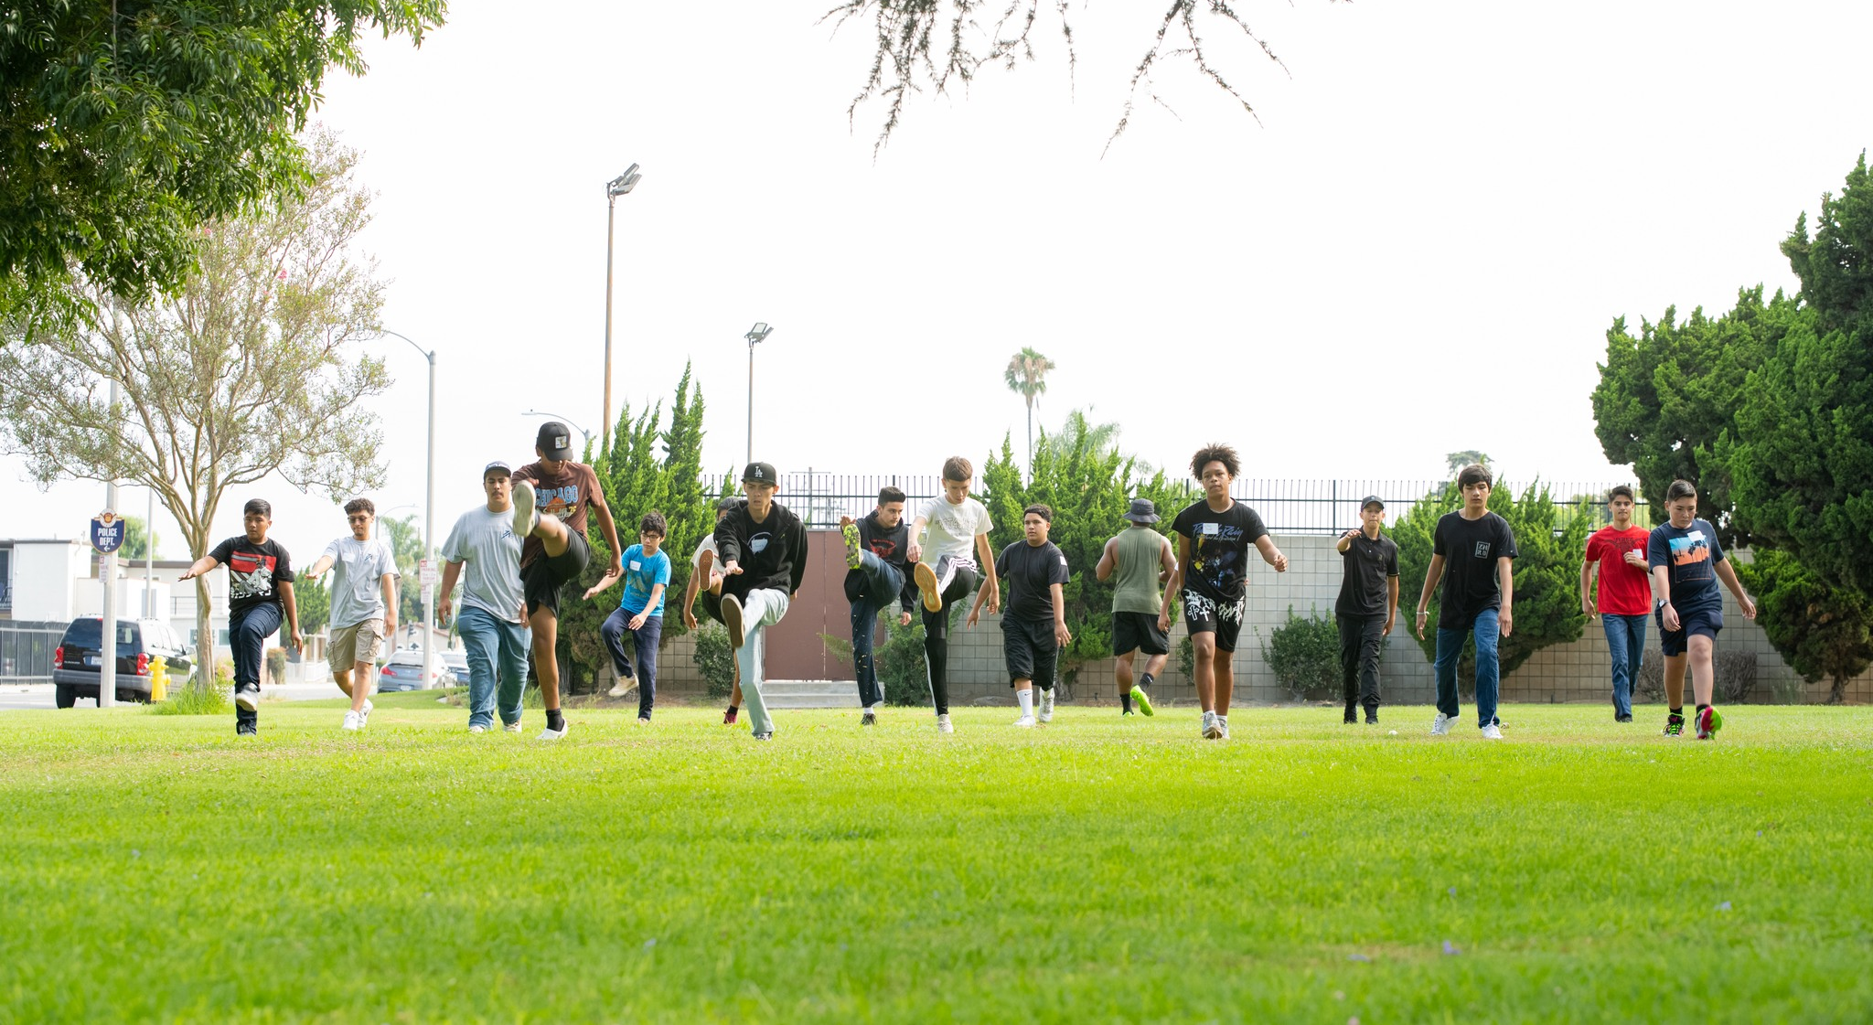
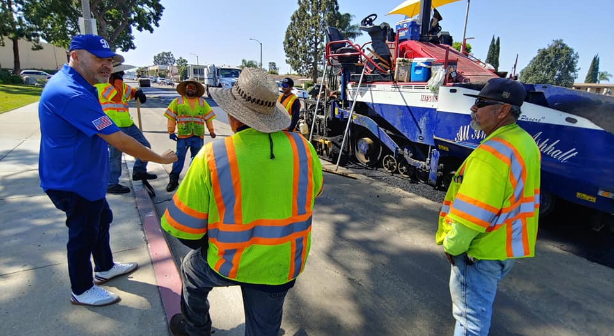
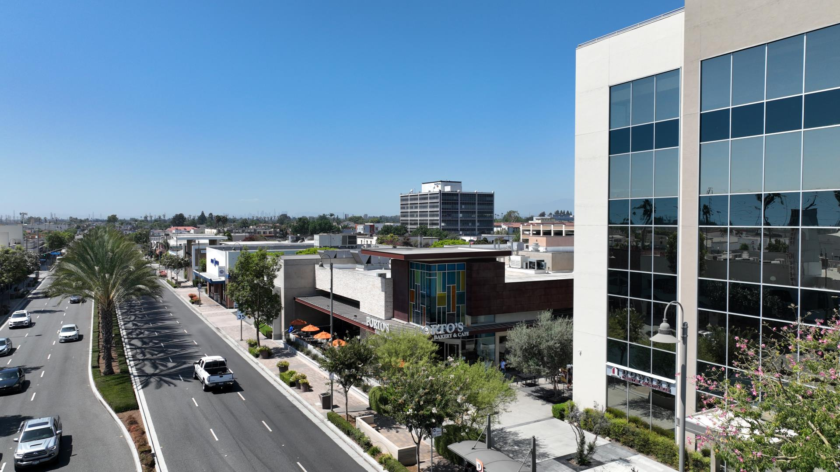
What Are My Neighbors Saying?
Residents have identified the following Downey priorities:
Maintaining 911 emergency responses
Preventing crimes including thefts and burglaries
Helping ensure children have safe places to play
Recruiting and retaining well-trained firefighters and paramedics
Repairing streets and potholes
Retaining and attracting local businesses

Slide 4
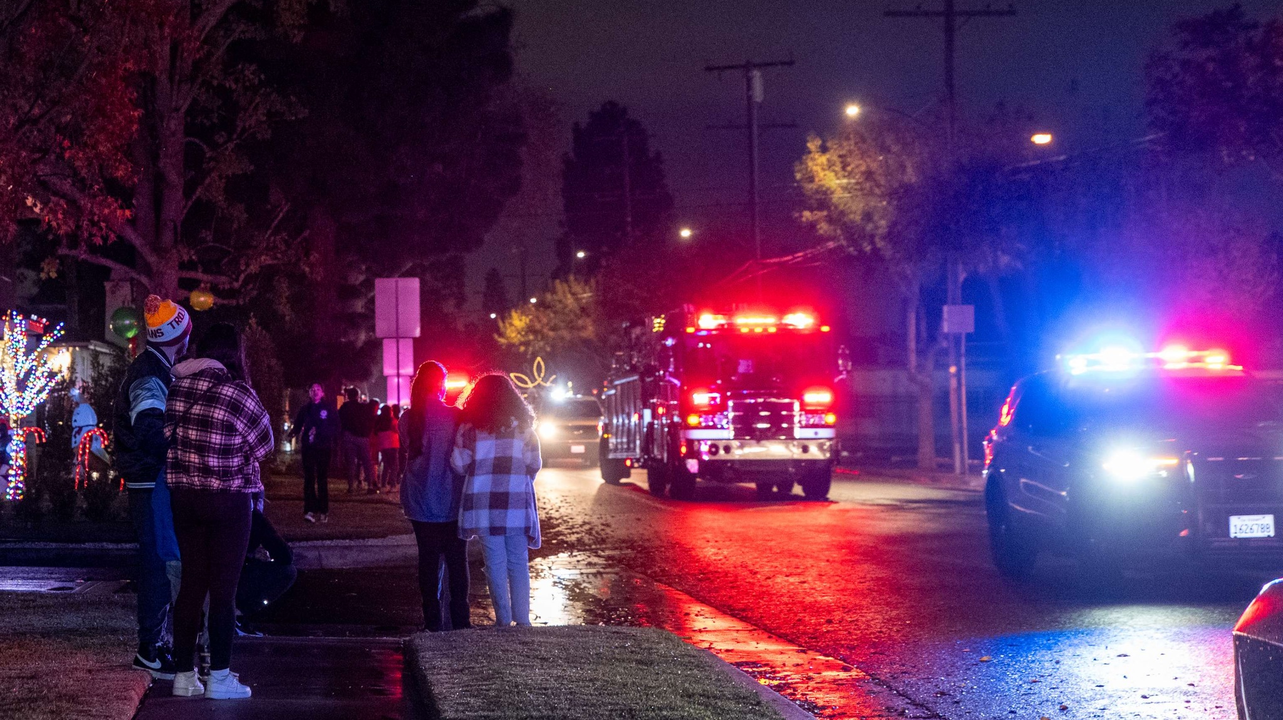
Did You Know Downey is a Full-Service City?
Downey is one of the few cities in the region to be a full-service City, including having our own police and fire departments.
Without maintaining these services, the look, feel and safety of our community may be at risk.
The City continues to work to help maintain local control of vital services, ensure adequate funding and resources for our first responders, parks, road maintenance as well as youth and senior programs; and maintain the highest quality of life in the area.

Slide 5
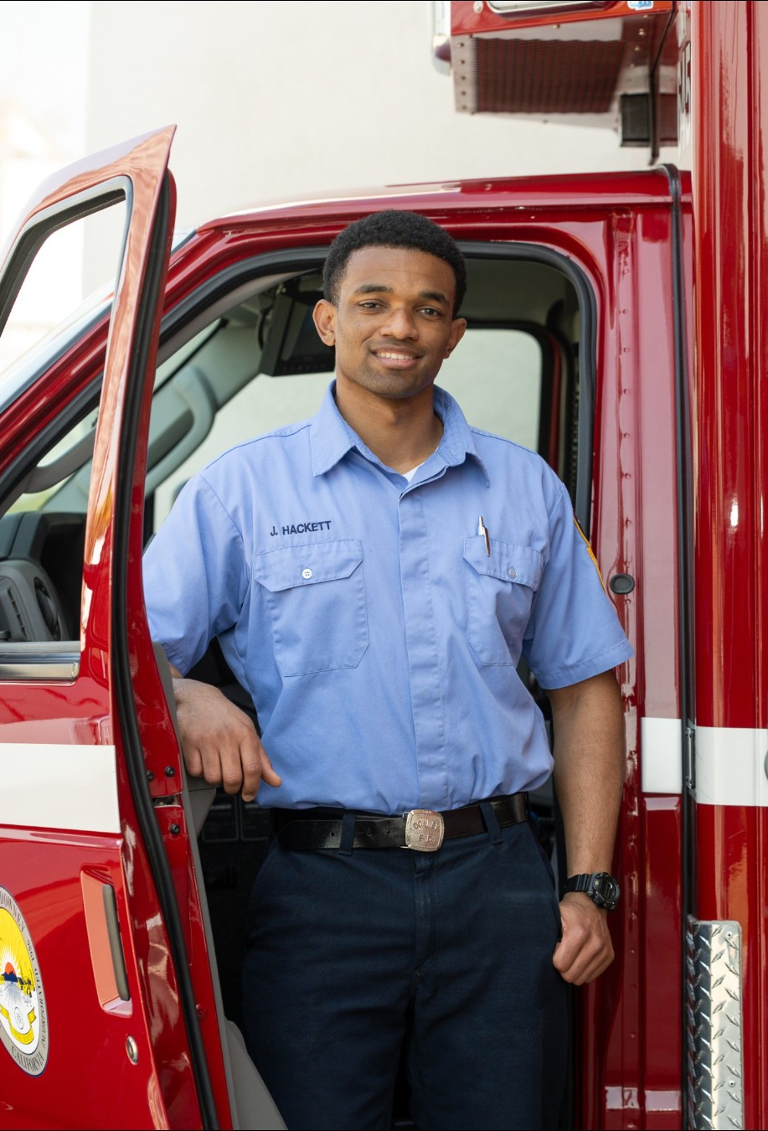
Maintaining 911 Emergency Medical Response
Over 70% of calls to the Downey Fire Department are related to medical emergencies.
When seconds in an emergency count, the City must be able to maintain and improve response times.
The City must also ensure we can recruit and retain well-qualified firefighters and paramedics as well as ensure they have lifesaving equipment to respond to emergencies and save lives.

Slide 6
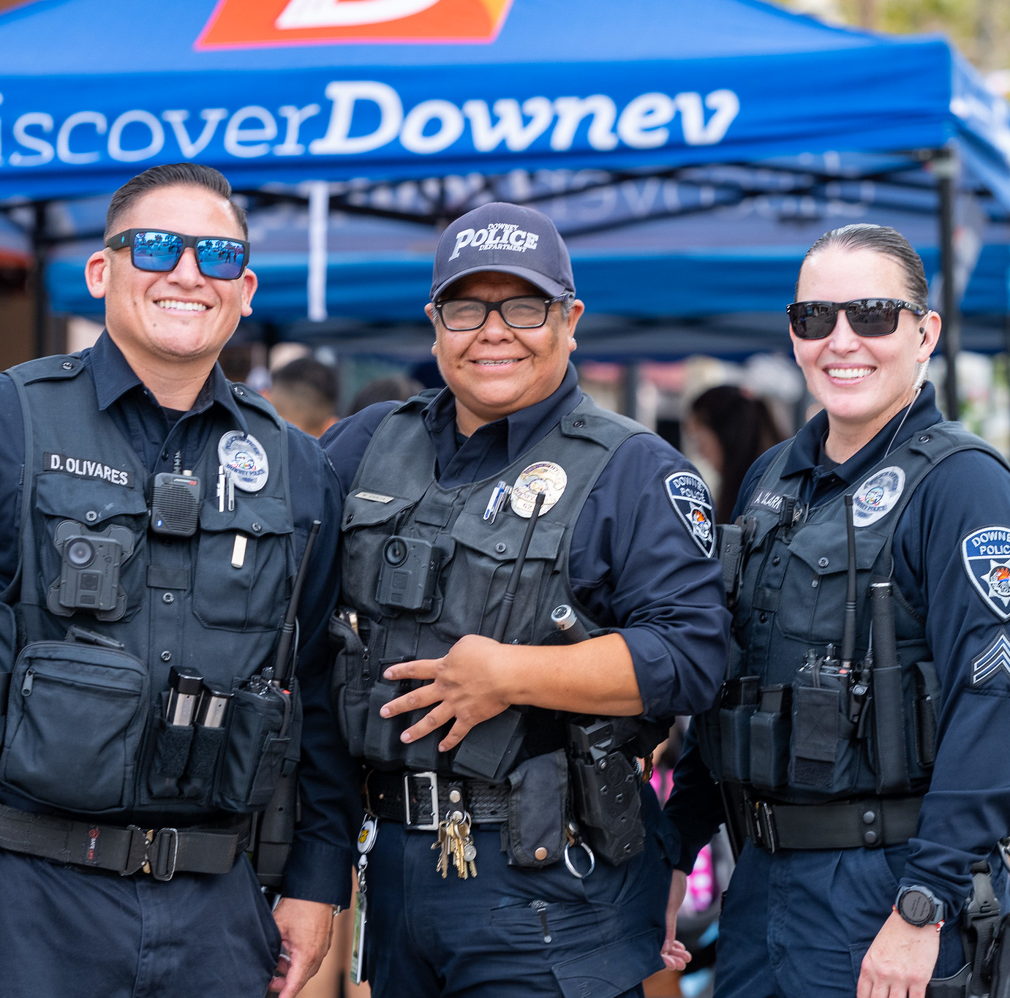
What is the City doing to fight crime?
The Police Department continues to work hard to keep our community safe
Similar to communities across the region, last year Downey saw a 5 year high in reported crimes.
In 2023, there were over a combined 3,100 robberies, burglaries, and thefts, including auto thefts.
The City seeks to maintain 911 emergency response times and police patrols in neighborhoods and business areas to keep residents and their properties safe.

Slide 7
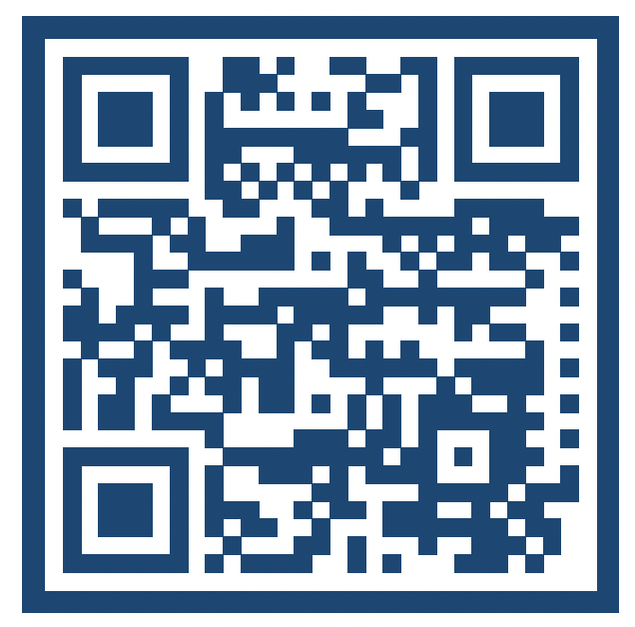
How Can You Join the Discussion?
We want to hear from you! Join the Downey Discussion today!
Scan the QR Code or
Visit: www.DowneyCA.org/Discussion

Slide 8
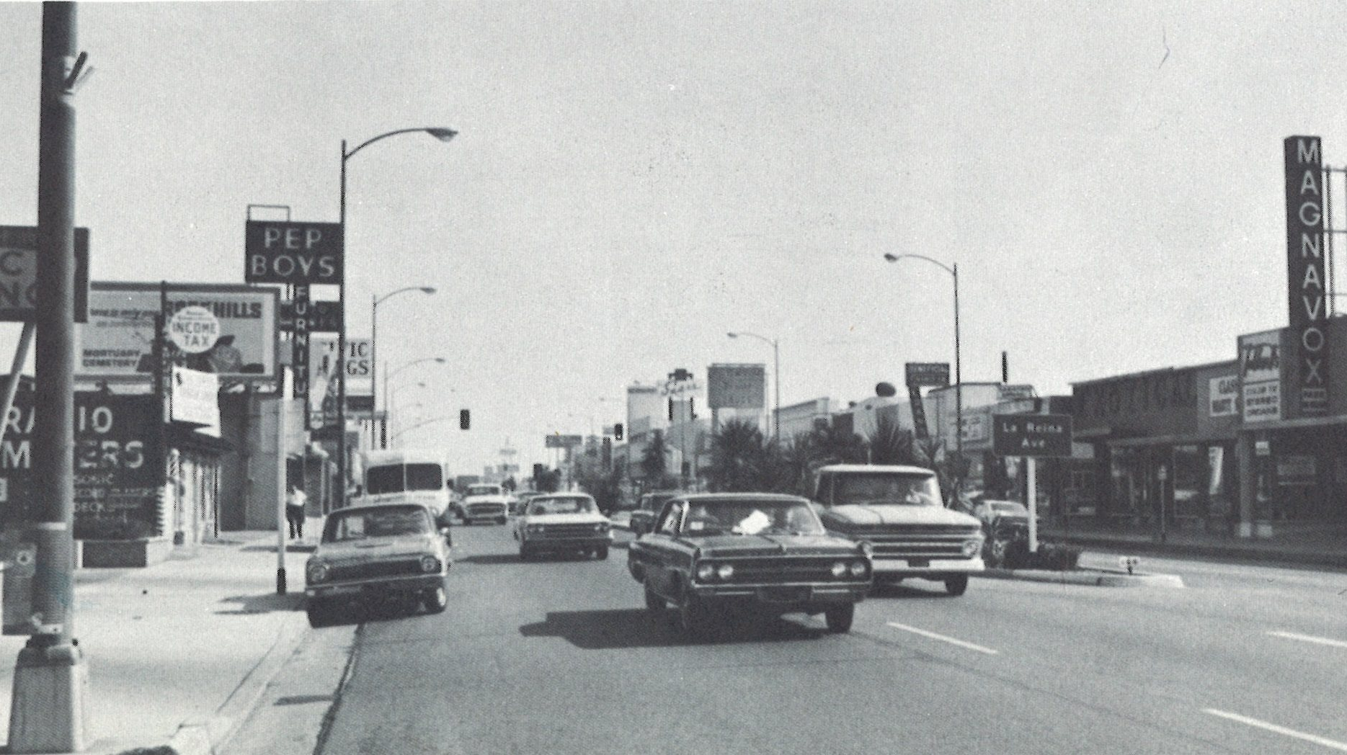
Questions?

